Slide 1
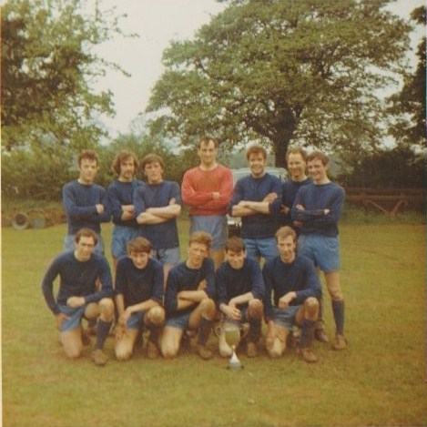
Ivor Braggins Keith Sandham Robert Coleman Vic King Norman Blencowe Malc Timms John Goodman
Peter Bray Michael Watts Paul Wilkins Mike Dale Derek Wyatt

